Slide 1


STES’S Sou. Venutai Chavan Polytechnic, Pune Dept. of Computer Technology
MSBTE
Year 2017-2018

Slide 2
Garbage Monitoring & Management
Presented by:
04 Prajval Santosh Chavan
08 Sumit Rajaram Ghadi
21 Sairaj Vivek Nanaware
30 Sameer Laxman Sawant
Guide - Mrs. S.M.Mate

Slide 3
Index
Abstract
Existing System
Proposed System Architecture
Components
Disadvantages of the existing system
Advantages of the proposed system

Slide 4
Abstract
In our country the dustbins placed at public places are overloaded.
It is unhygienic for people
This ugliness led to bad smell to people leaving around that particular area.
To avoid this, we are implementing a project called IoT Based Smart Garbage Collection system.
We are also providing waste management by seperating wet trash and dry trash.

Slide 5
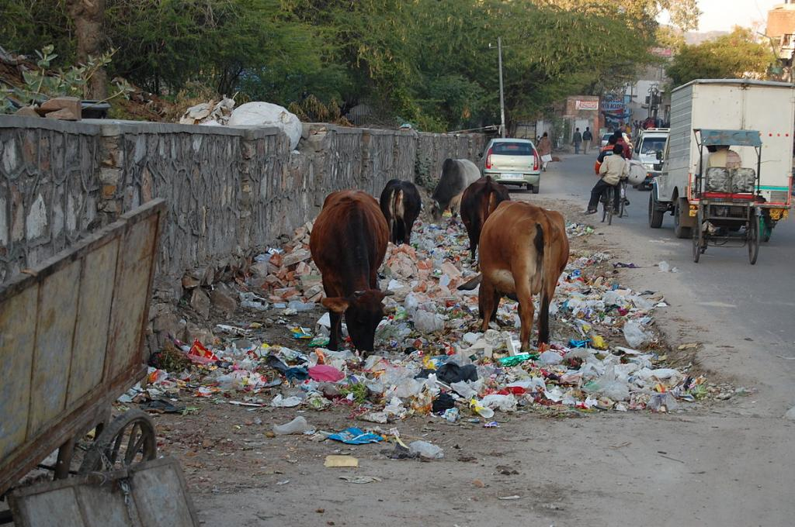
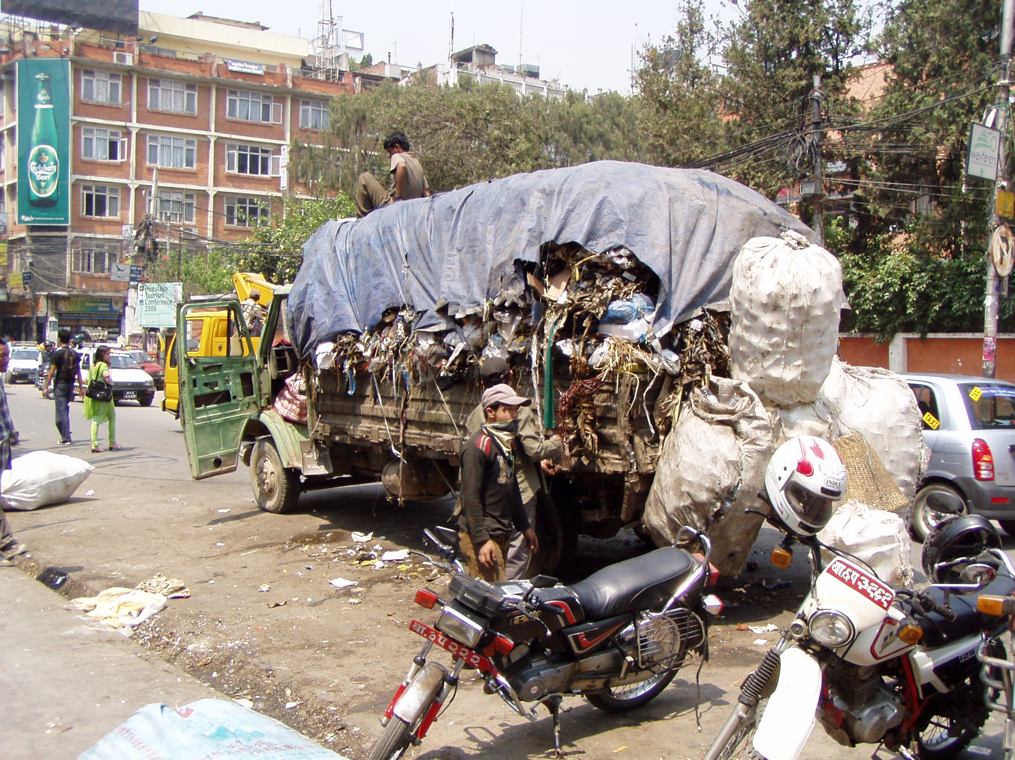
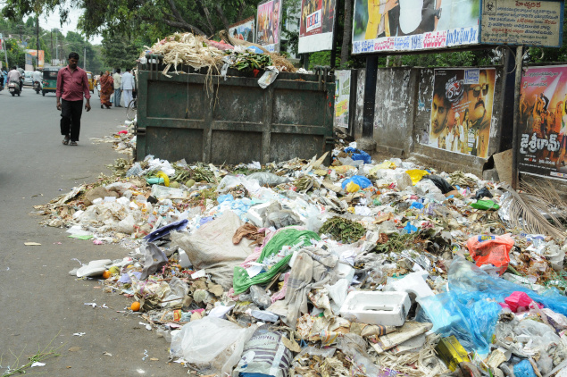
Existing System

Slide 6
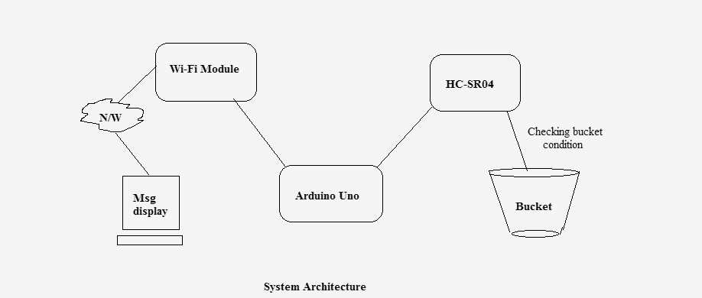
Proposed System Achitecture

Slide 7
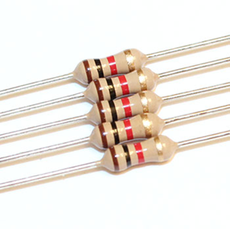
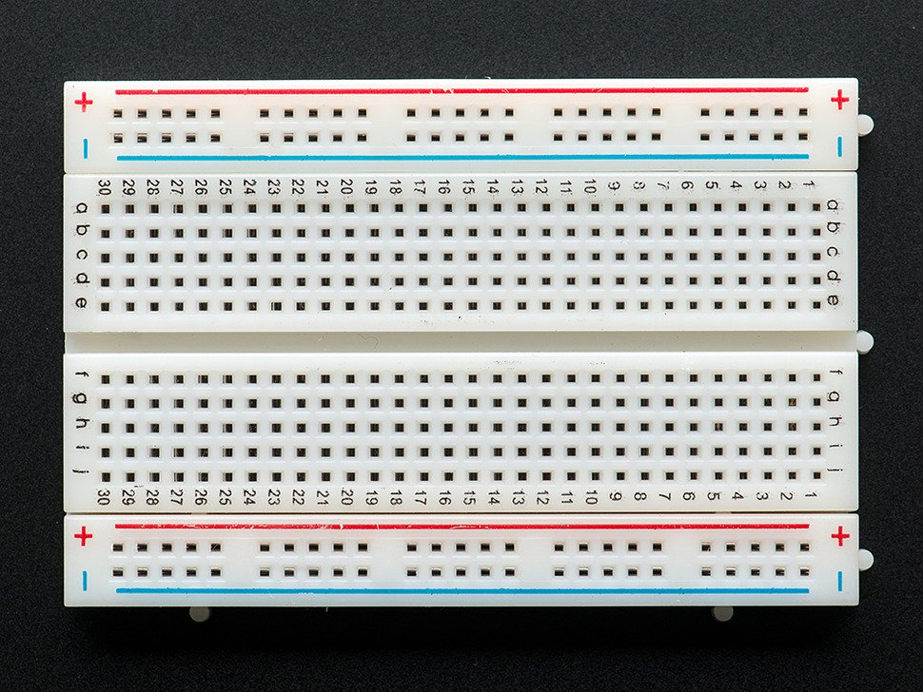
Components
Arduino Uno
ESP8266 Wi-Fi module
HC-SR04 Ultrasonic sensor
1K Resistors
Breadboard
Connecting wires

Slide 8
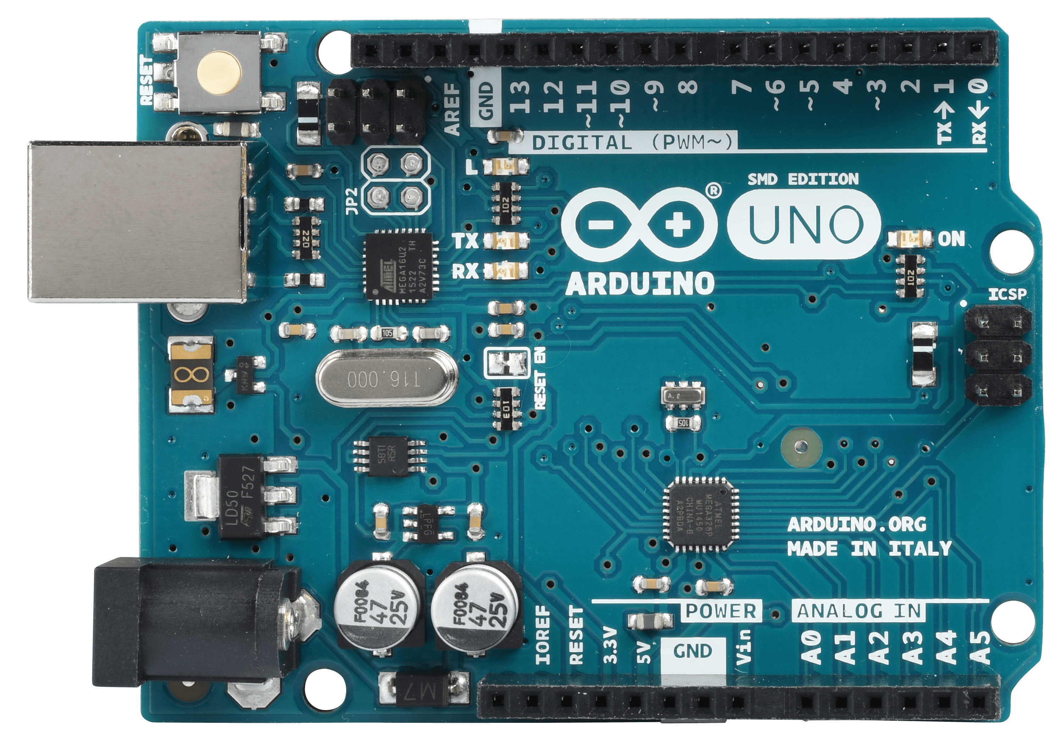
Arduino Uno
The Arduino Uno is a microcontroller board based on the ATmega328.
Features :
It connect to a computer with a USB cable.
Power it with a AC-to-DC adapter.
Specification :
It has 20 digital input/output pins.
A 16 MHz resonator, a USB connection.
A power jack.

Slide 9
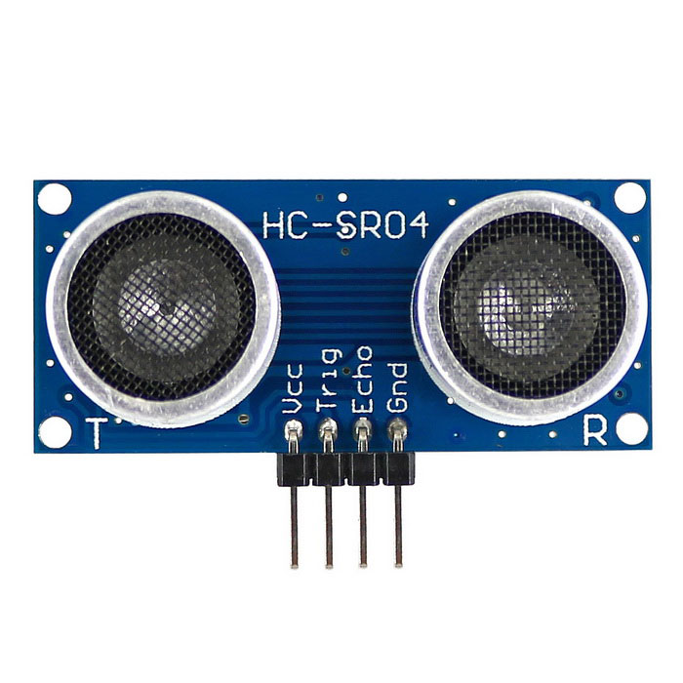
Ultrasonaic-Sensor-HC-SR04
The Ultrasonic Sensor is used to measure the distance
High accuracy and stable readings.
It can measure distance from 2cm to 400cm or from 1 inch to 13 feet.
The RX pin works on 3.3V

Slide 10
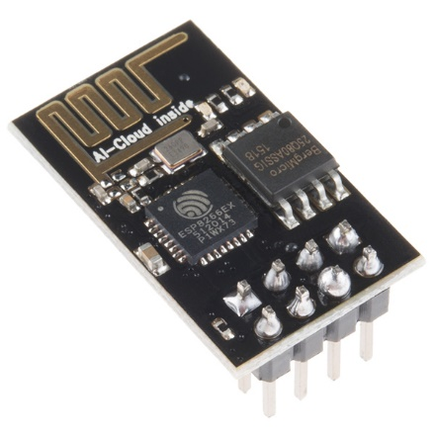
ESP8266 Wi-Fi Module
ESP8266 is a Wi-Fi module - access to Wi-Fi or internet.
Most leading devices in the IOT platform.
It is a very cheap device but it is very powerful.
Communicate with any microcontroller.
It runs only on 3.3V power supply.

Slide 11
Disadvantages of the existing system
Time consuming and less effective.
High costs.
Unhygienic Environment and look of the city.
Bad smell spreads and may cause illness to human beings.

Slide 12
Advantages of the proposed system
Real time information on the fill level of the dustbin. Deployment of dustbin based on the actual needs.
Cost Reduction and resource optimization.
Fewer smells
Cleaner cities
Intelligent management of the services in the city. Effective usage of dustbins.

Slide 13
References
https://en.m.wikipedia.org/wiki/Waste_management
https://en.m.wikipedia.org/wiki/Arduino
http://www.keyence.com/ss/products/sensor/sensorbasics/ultrasonic/info

Slide 14
Thank You.......

